Slide 1
TensorFlow Model for Embedded Object Detection
ECEN 5060 Deep Learning
Brady Barlow

Slide 2
Problem Statement
Advances in machine learning have made it possible to implement TensorFlow models on microcontrollers, paving the way for real-time object detection and decision-making in compact, resource-constrained environments. The goal of this project is to develop a modular architecture to scale a large TensorFlow model down to TensorFlow Lite model for deployment on a SparkFun Thing Plus RP2040 microcontroller with an attached ARDUCAM and OLED.

Slide 3
Software Selections
The dataset used for this project is COCO 2017, containing 118,287 images with multilabel annotations. To align with road object detection goals, only bicycle, car, motorcycle, bus, truck, traffic light, and stop sign classes were used.
MobileNetV2 was selected for its efficiency and trained using a two-stage approach to optimize for these specific classes.
Due to current limitations with LiteRT on the RP2040 platform, and with pico-tflmicro being the officially supported TensorFlow Lite Micro implementation for RP2040, TensorFlow was chosen over PyTorch to allow direct model conversion to TFLite and C header files for embedded deployment.

Slide 4
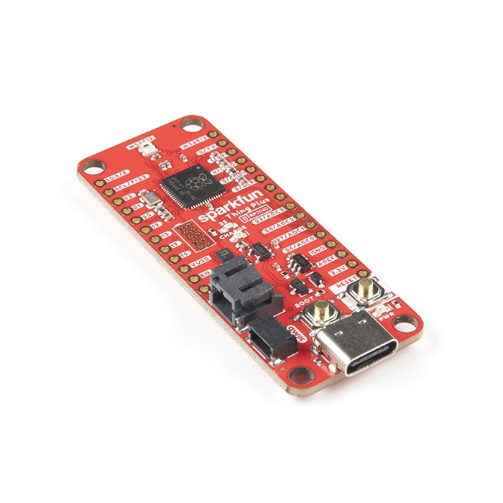
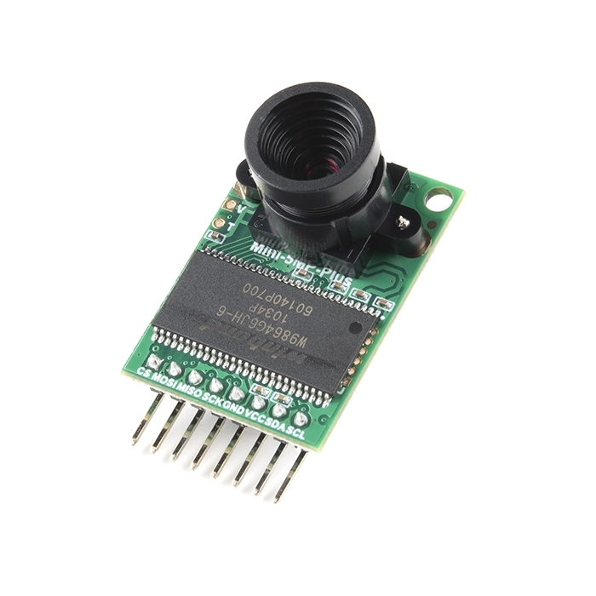
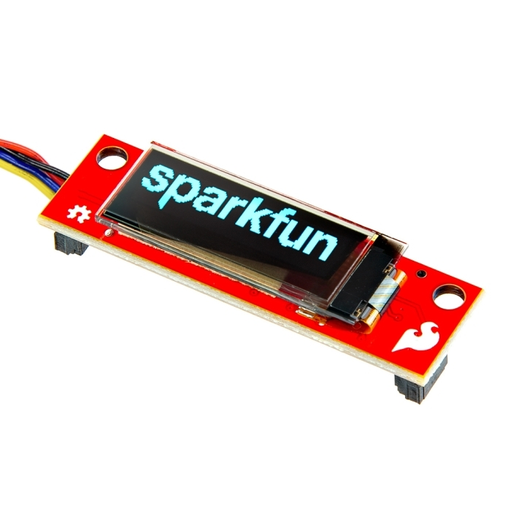
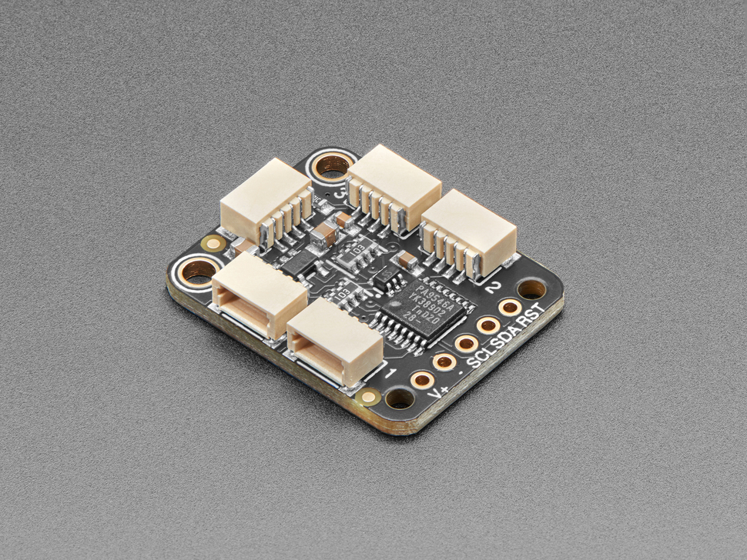
Hardware Selections
SparkFun Thing Plus - RP2040
Arducam 5MP Plus OV5642 Mini Camera Module
https://www.sparkfun.com/sparkfun-qwiic-oled-display-0-91-in-128x32-lcd-24606.html
Adafruit PCA9546 4-Channel STEMMA QT / Qwiic I2C Multiplexer - TCA9546A Compatible

Slide 5
Configuration
# ─── CONFIGURATION ─────────────────────────────────────────────────────────── BATCH_SIZE = 32 FROZEN_EPOCHS = 10 FINE_TUNE_EPOCHS = 30 INITIAL_LR = 1e-3 IMG_HEIGHT, IMG_WIDTH = 64, 64 IMG_SIZE = (IMG_HEIGHT, IMG_WIDTH) SEED = 42 NICKNAME = 'RoadLiteMobileNetV2' EXPORT_DIR = './export' DATA_DIR = './Data' EXCEL_DIR = './excel' PREDICTION_DIR = './predictions' # Set seeds for reproducibility random.seed(SEED) np.random.seed(SEED) tf.random.set_seed(SEED) # Road object classes to detect ROAD_CLASSES = ['bicycle', 'car', 'motorcycle', 'bus', 'truck', 'traffic light', 'stop sign'] NUM_CLASSES = len(ROAD_CLASSES) # Create necessary directories for directory in [EXPORT_DIR, DATA_DIR, EXCEL_DIR, PREDICTION_DIR]: os.makedirs(directory, exist_ok = True)

Slide 6
# ─── MODEL BUILDING ────────────────────────────────────────────────────────── def build_model(trainable_base = False, fine_tuning = False): """Build the MobileNetV2-based model""" # Load MobileNetV2 with pre-trained weights, using alpha=0.35 for a smaller model base_model = MobileNetV2( input_shape = (*IMG_SIZE, 3), include_top = False, weights = 'imagenet', alpha = 0.35 # Lighter model ) # Set base model trainable status base_model.trainable = trainable_base # If fine-tuning, only make the last few layers trainable if fine_tuning: for layer in base_model.layers[:-20]: layer.trainable = False # Build model model = models.Sequential([ base_model, layers.GlobalAveragePooling2D(), layers.Dropout(0.5), # Prevent overfitting layers.Dense(128, activation = 'relu'), layers.Dropout(0.3), # Additional dropout layers.Dense(NUM_CLASSES, activation = 'sigmoid') ]) # Compile with appropriate learning rate model.compile( optimizer = tf.keras.optimizers.Adam( INITIAL_LR if not fine_tuning else INITIAL_LR * 0.1, clipnorm = 1.0 # Gradient clipping for stability ), loss = 'binary_crossentropy', metrics = [ tf.keras.metrics.BinaryAccuracy(name = 'binary_accuracy'), tf.keras.metrics.Precision(name = 'precision'), tf.keras.metrics.Recall(name = 'recall'), tf.keras.metrics.AUC(name = 'auc') ] ) return model
Model Building

Slide 7
# ─── STAGE 1: FROZEN BASE TRAINING ─────────────────────────────────────────── print("\n=== Stage 1: Training with Frozen Base Model ===") stage1_model = build_model(trainable_base = False) # Callbacks metrics_callback = MetricsCallback(test_ds, ROAD_CLASSES, df_test) early_stop = EarlyStopping( monitor = 'val_f1_macro', mode = 'max', patience = 7, restore_best_weights = True, verbose = 1 ) checkpoint = ModelCheckpoint( os.path.join(EXPORT_DIR, 'best_model_stage1.keras'), monitor = 'val_f1_macro', mode = 'max', save_best_only = True, verbose = 1 ) reduce_lr = ReduceLROnPlateau( monitor = 'val_f1_macro', mode = 'max', factor = 0.5, patience = 3, min_lr = 1e-6, verbose = 1 ) # Train stage 1 history_stage1 = stage1_model.fit( train_ds, epochs = FROZEN_EPOCHS, validation_data = test_ds, callbacks = [metrics_callback, early_stop, checkpoint, reduce_lr], verbose = 1 )
Stage 1 Training

Slide 8
# ─── STAGE 2: FINE TUNING ─────────────────────────────────────────────────── print("\n=== Stage 2: Fine-tuning Model ===") # Load best stage 1 model stage1_model = tf.keras.models.load_model( os.path.join(EXPORT_DIR, 'best_model_stage1.keras') ) # Create fine-tuning model stage2_model = build_model(trainable_base = True, fine_tuning = True) # Copy weights from stage 1 stage2_model.set_weights(stage1_model.get_weights()) # Callbacks for stage 2 metrics_callback_stage2 = MetricsCallback(test_ds, ROAD_CLASSES, df_test) early_stop_stage2 = EarlyStopping( monitor = 'val_f1_macro', mode = 'max', patience = 10, restore_best_weights = True, verbose = 1 ) checkpoint_stage2 = ModelCheckpoint( os.path.join(EXPORT_DIR, 'best_model_final.keras'), monitor = 'val_f1_macro', mode = 'max', save_best_only = True, verbose = 1 ) reduce_lr_stage2 = ReduceLROnPlateau( monitor = 'val_f1_macro', mode = 'max', factor = 0.2, patience = 5, min_lr = 1e-7, verbose = 1 ) # Train stage 2 history_stage2 = stage2_model.fit( train_ds, epochs = FINE_TUNE_EPOCHS, validation_data = test_ds, callbacks = [metrics_callback_stage2, early_stop_stage2, checkpoint_stage2, reduce_lr_stage2], verbose = 1 )
Stage 2 Training

Slide 9
Exporting TFLite
# ─── EXPORT TO TFLITE ──────────────────────────────────────────────────────── print("\n=== Converting to TFLite for RP2040 Deployment ===") # Load the best model final_model = tf.keras.models.load_model( os.path.join(EXPORT_DIR, 'best_model_final.keras') ) # Summary of the model final_model.summary() # Define a representative dataset for quantization def representative_dataset(): """Generate representative dataset for quantization""" for i in range(100): row = df_train.sample(1).iloc[0] img_path = os.path.join(DATA_DIR, row['filename']) img = cv2.imread(img_path) img = cv2.resize(img, IMG_SIZE) img = img.astype(np.float32) / 255.0 yield [np.expand_dims(img, axis = 0)] # Create TFLite converter converter = tf.lite.TFLiteConverter.from_keras_model(final_model) # Apply optimizations for RP2040 converter.optimizations = [tf.lite.Optimize.DEFAULT] converter.representative_dataset = representative_dataset converter.target_spec.supported_ops = [tf.lite.OpsSet.TFLITE_BUILTINS_INT8] converter.inference_input_type = tf.float32 converter.inference_output_type = tf.uint8 # Convert model tflite_model = converter.convert() # Save TFLite model tflite_path = os.path.join(EXPORT_DIR, f"{NICKNAME}.tflite") with open(tflite_path, 'wb') as f: f.write(tflite_model) print(f"TFLite model saved: {tflite_path}") print(f"TFLite model size: {len(tflite_model) / 1024:.2f} KB")
Total params: 1,402,967 (5.35 MB)
Trainable params: 413,943 (1.58 MB)
Non-trainable params: 161,136 (629.44 KB)
Optimizer params: 827,888 (3.16 MB)
TFLite model size: 771.81 KB

Slide 10
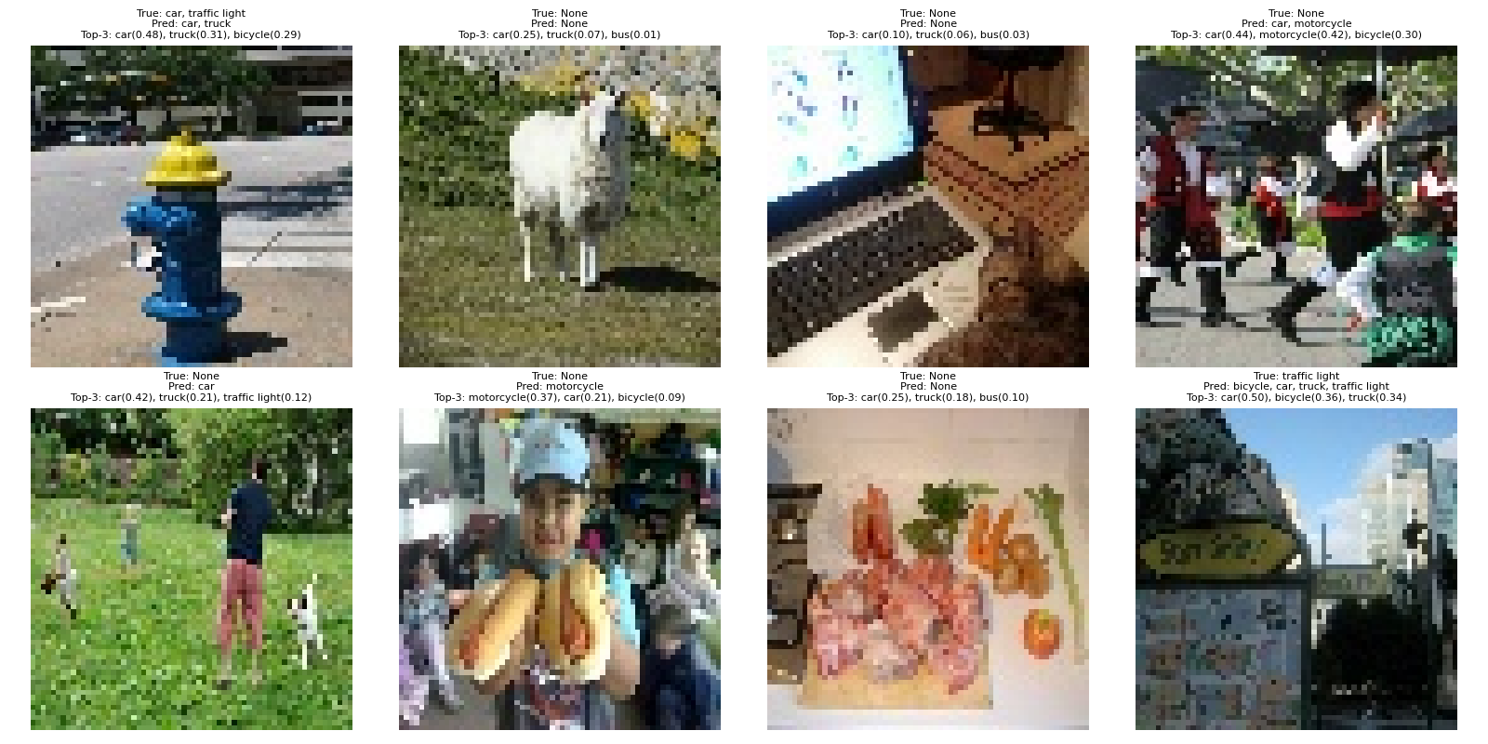
Keras Prediction

Slide 11
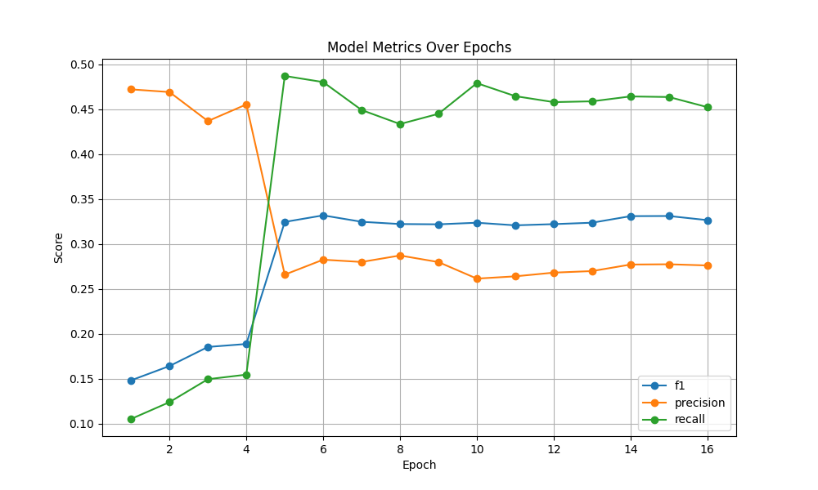
Results From Training

Slide 12
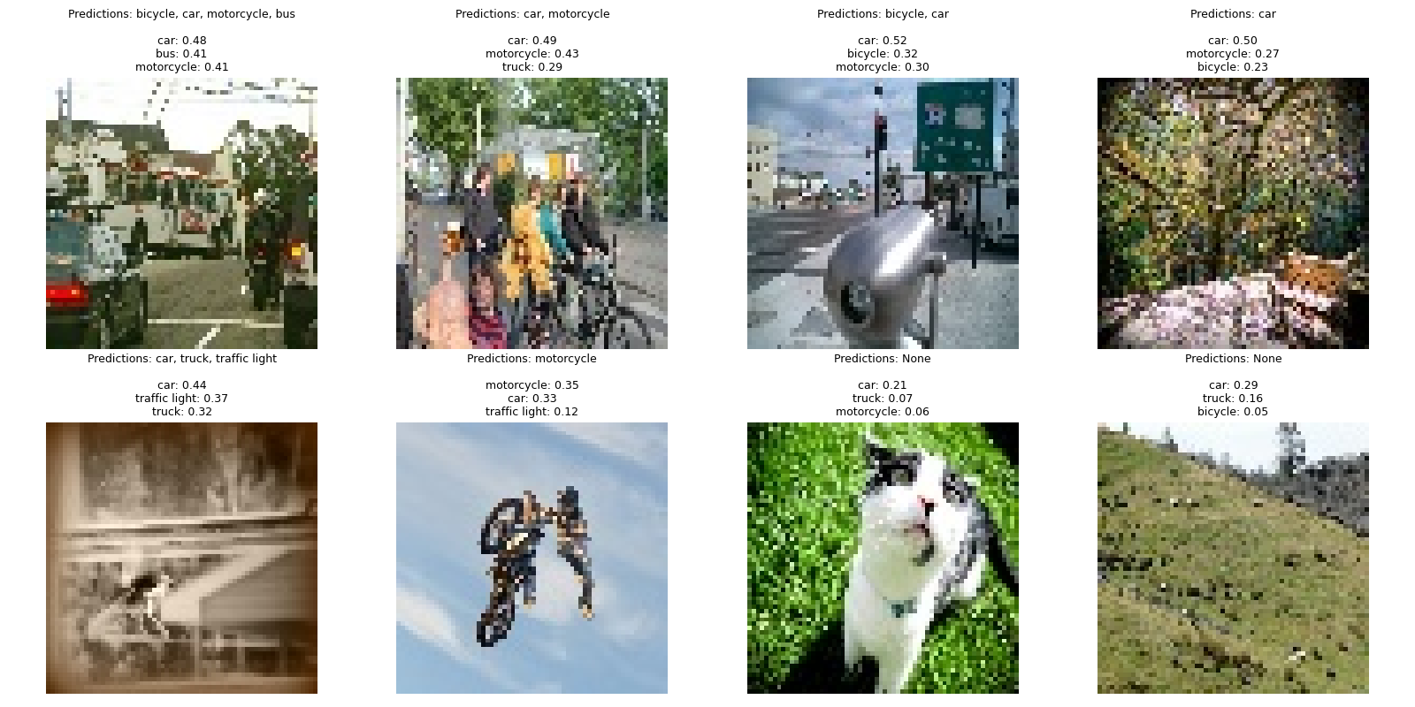
TFLite Prediction

Slide 13
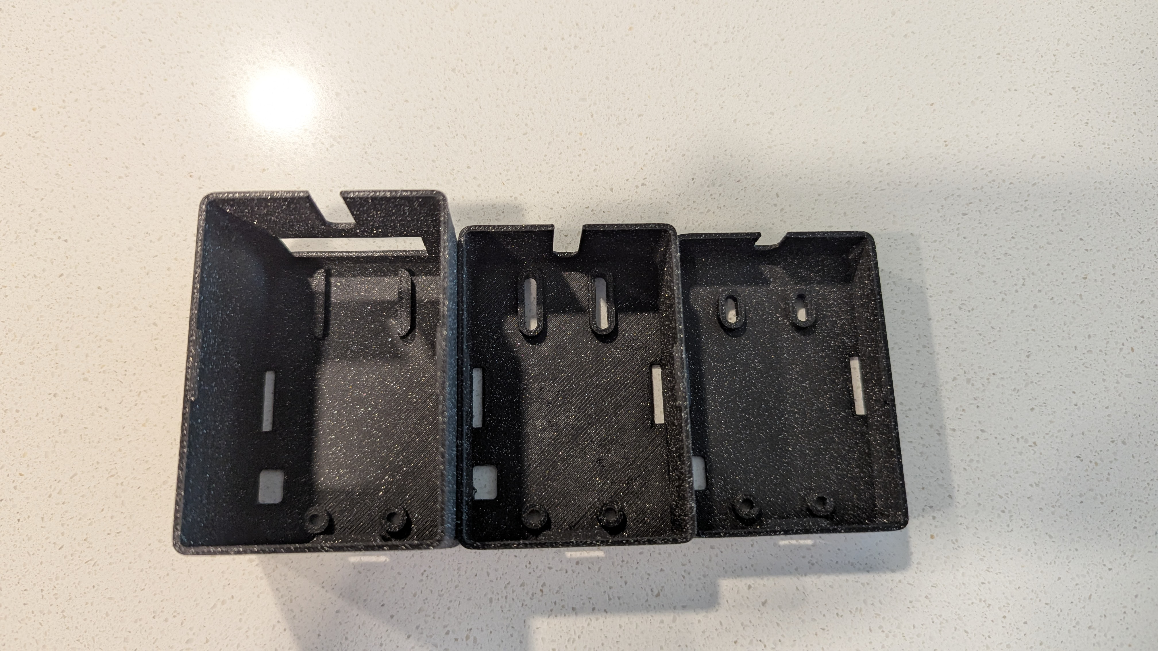
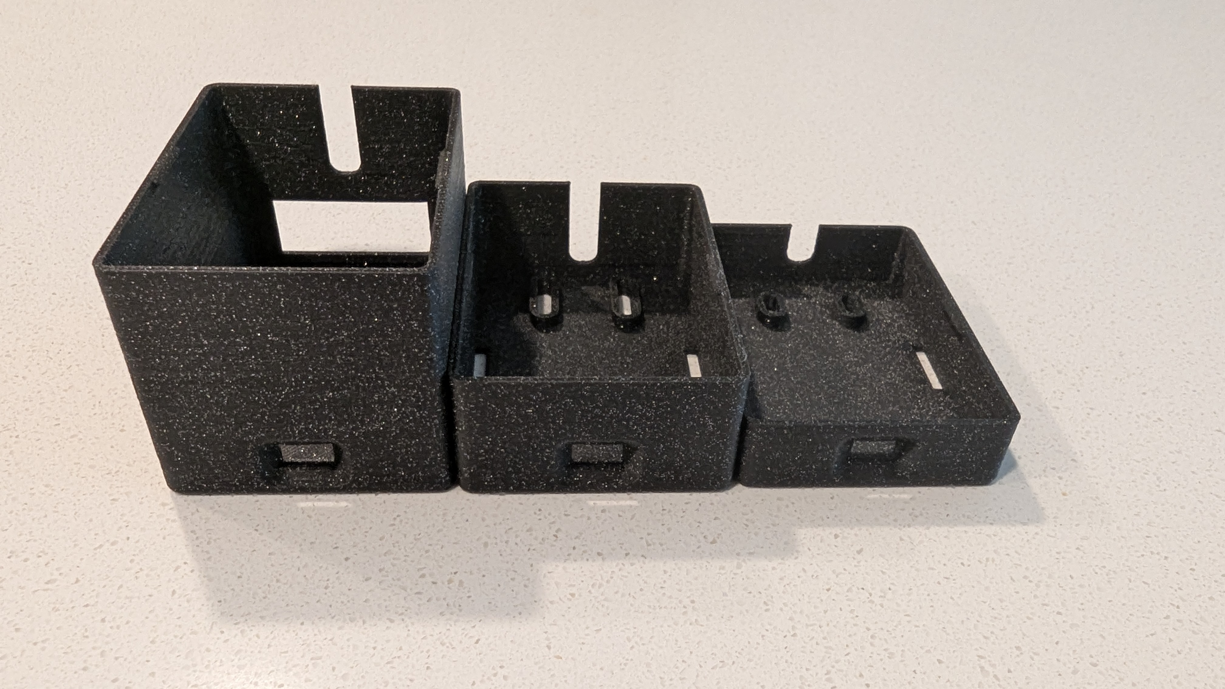
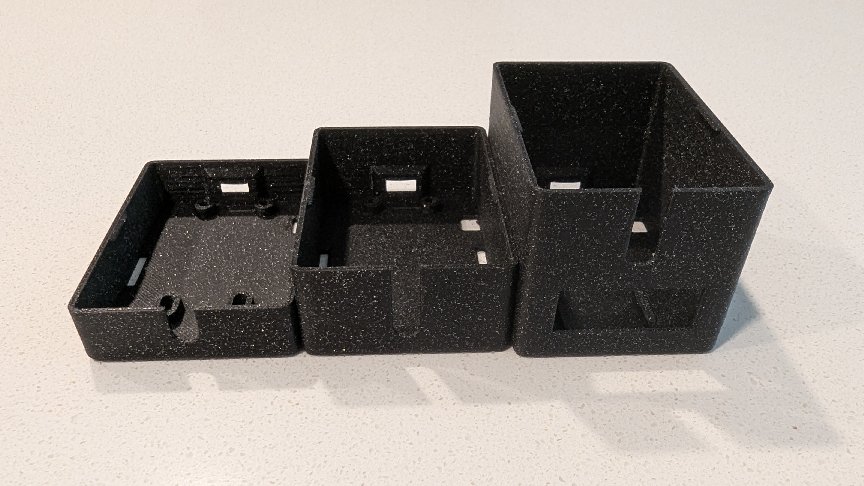
Header Generation And Initial Design Of Enclosure
with open('export/RoadLiteMobileNetV2.tflite', 'rb') as f: data = f.read() with open('export/model_data.h', 'w') as f: f.write('const unsigned char model_data[] = {\n') for i, b in enumerate(data): if i % 12 == 0: f.write('\n ') f.write(f' 0x{b:02x},') f.write('\n};\nconst int model_data_len = sizeof(model_data);\n')

Slide 14
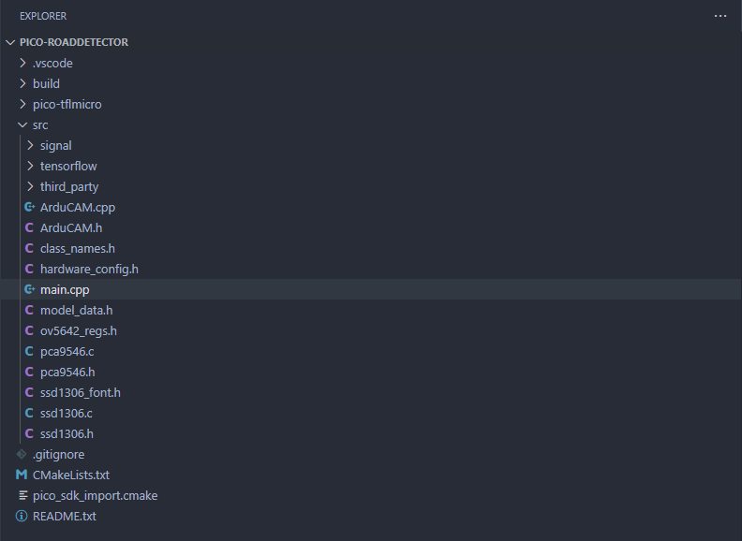
Pico Deployment and results
Setting up TensorFlow Lite...
Tensor arena size: 160 KB
Getting model from model_data (790336 bytes)...
Model version: 3, Schema version: 3
Creating op resolver...
Registering operations...
Building interpreter...
Allocating tensors...
Allocation status: 0 (0 is success)
Input tensor type: 1 (kTfLiteInt8=9, kTfLiteUInt8=3, kTfLiteFloat32=1)
Output tensor type: 3 (kTfLiteInt8=9, kTfLiteUInt8=3, kTfLiteFloat32=1)
Input tensor dims: 1 x 64 x 64 x 3
Output tensor dims: 1 x 7
Input tensor details - zero_point: 0, scale: 0.000000
Output tensor details - zero_point: 0, scale: 0.003906
Arena size: 127512 bytes used, 163840 bytes available
TensorFlow Lite ready

Slide 15
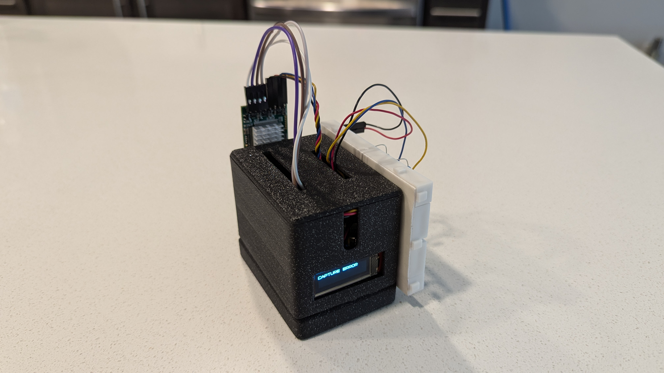
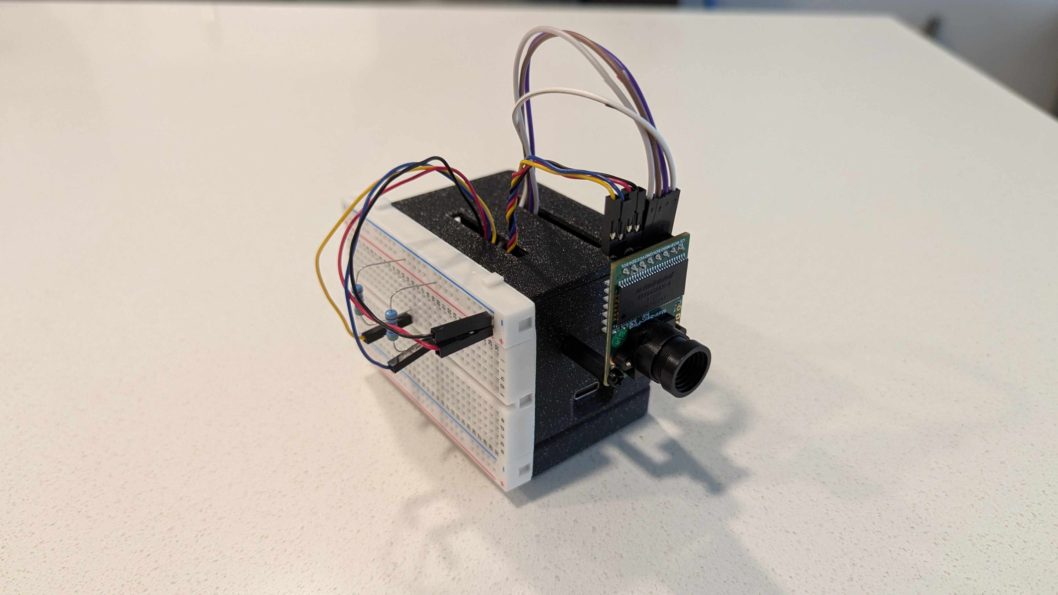
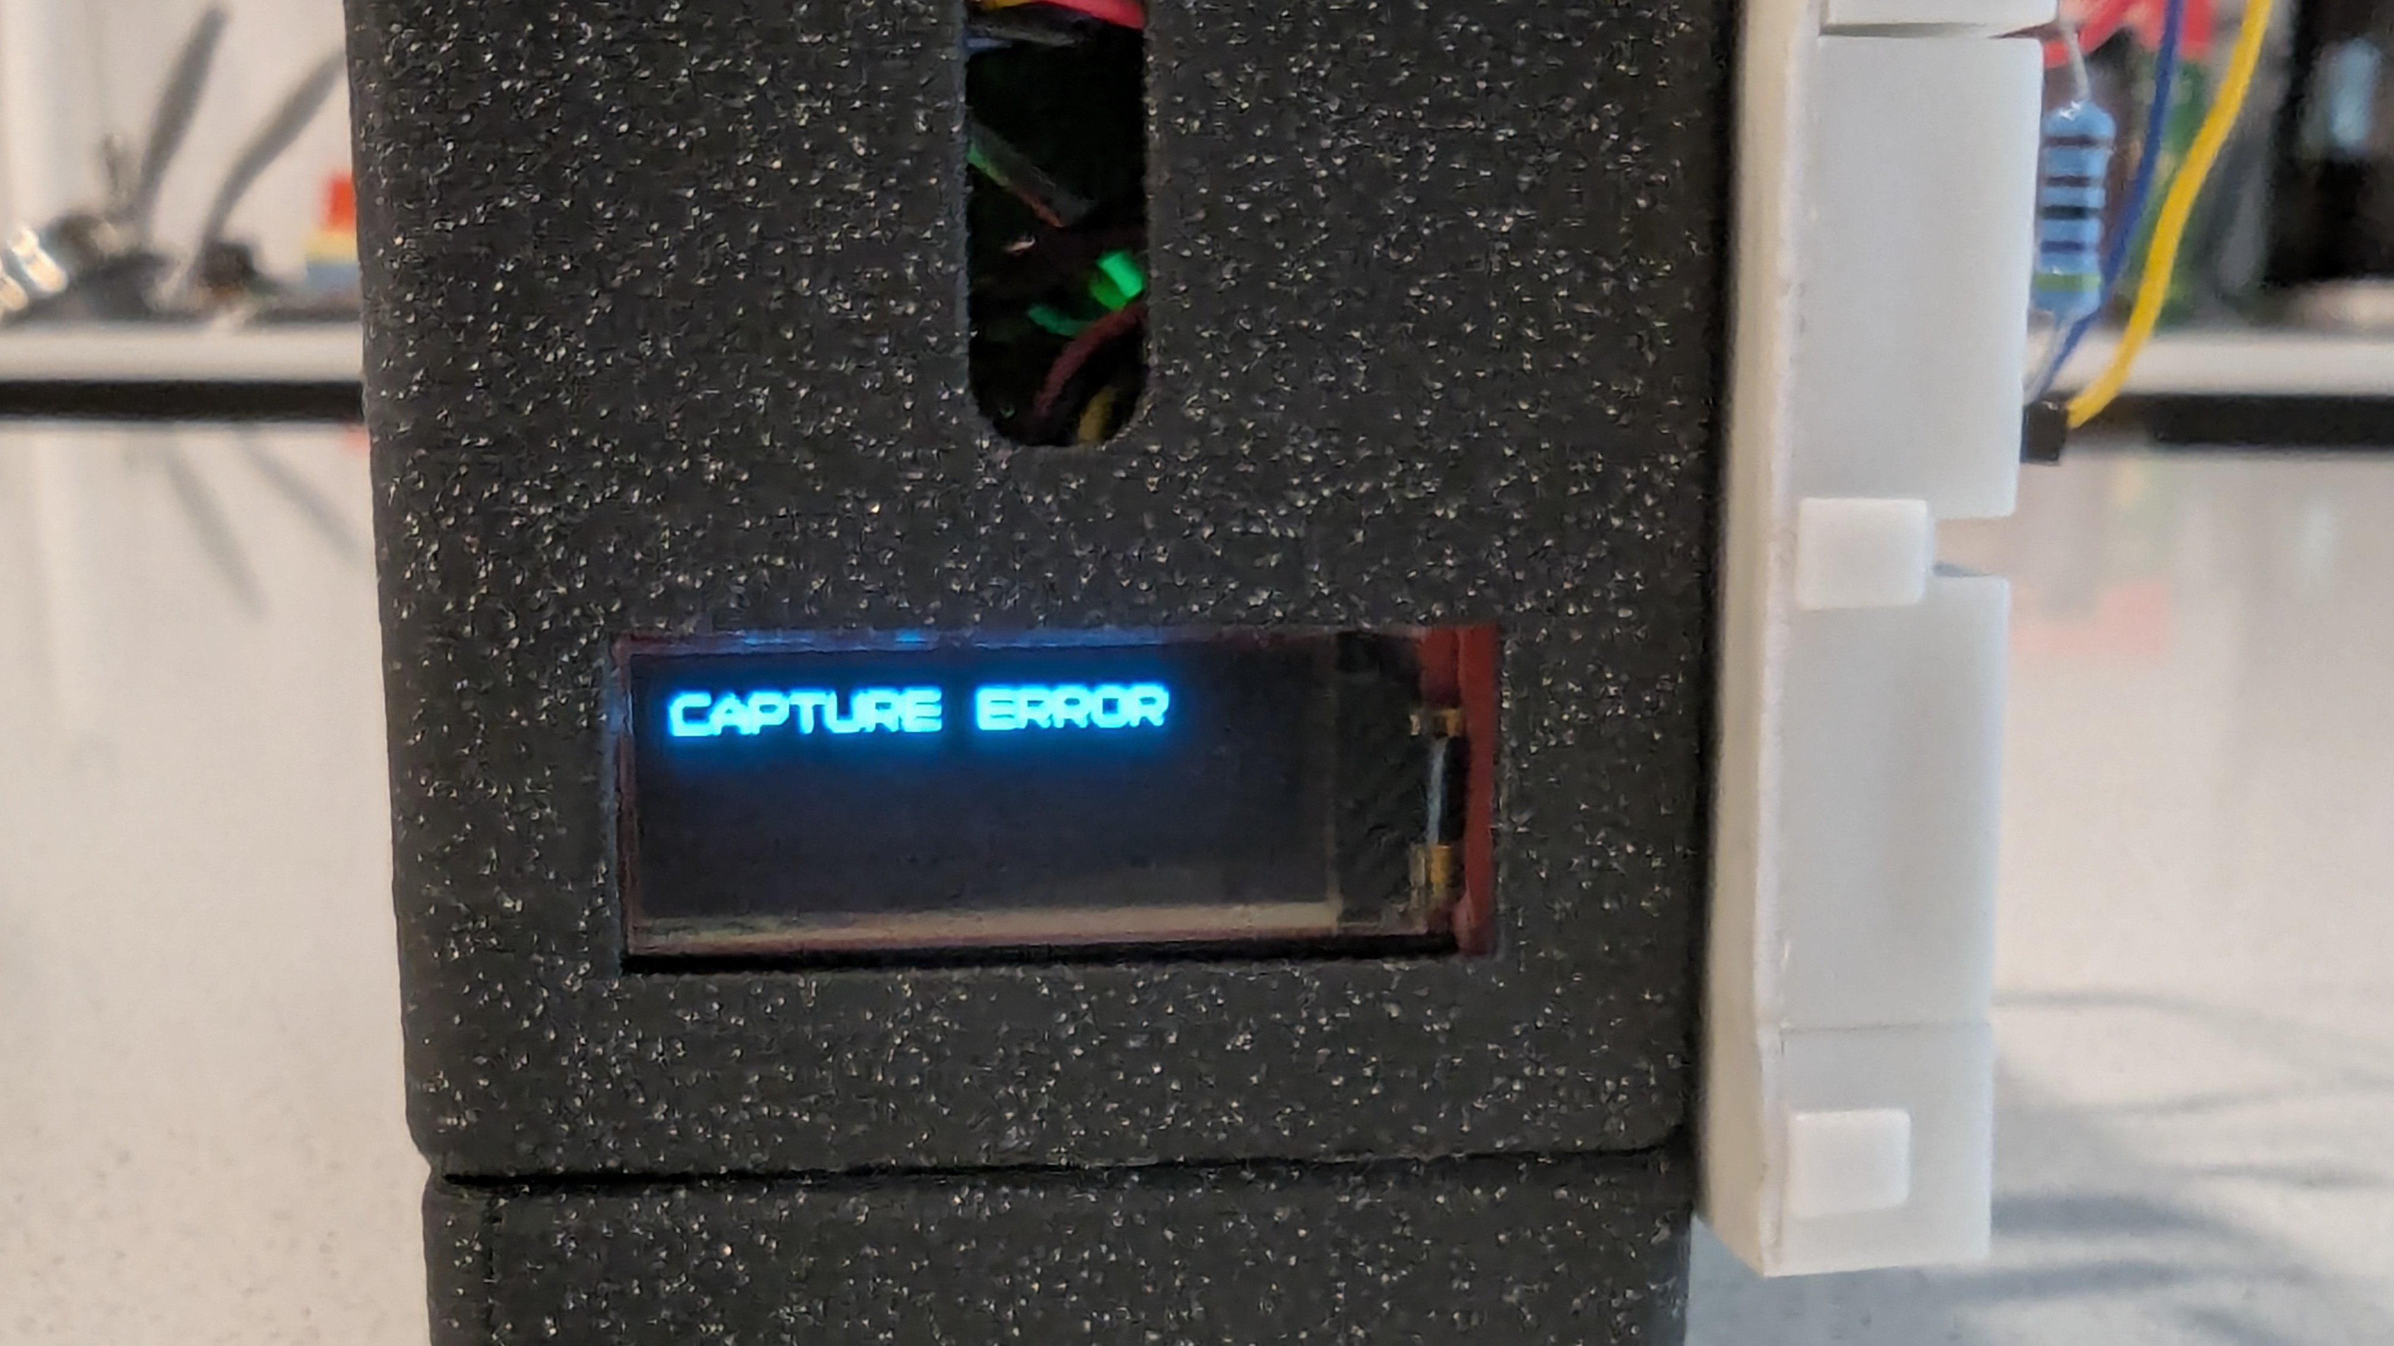
Conclusion

Slide 16
References
https://github.com/tensorflow/tflite-micro
https://github.com/raspberrypi/pico-tflmicro
https://cocodataset.org/#home
https://www.sparkfun.com/sparkfun-thing-plus-rp2040.html
https://www.sparkfun.com/arducam-5mp-plus-ov5642-mini-camera-module.html
https://www.sparkfun.com/sparkfun-qwiic-oled-display-0-91-in-128x32-lcd-24606.html
https://www.adafruit.com/product/5664
MORE REFERNCES WILL BE INCLUDED WITHIN FINAL REPORT.

